Slide 1
Capstone project

Slide 2
Fost & found
Team Members-
Gurjeet Kaur
Shailja Thakur
Rupali Rupali

Slide 3


Introduction
Foster care is a system in which a minor has been placed into a ward, group home (residential childcare community, treatment center, etc.), or private home of a state-certified caregiver, referred to as a "foster parent" or with a family member approved by the state. The placement of the child is normally arranged through the government or a social service agency.
So, foster&found will help foster kids to have access to the services and they can have a common platform where they can share their stories and meet new people.

Slide 4
WHY FOST AND FOUND?

Slide 5
Foster-care system
when looking at the negatives of foster care, you may conclude that the system sometimes fails children. Some kids, who should be adopted into a stable family, get passed around from family to family.
Sometimes foster parents fail to guide the foster kids, so they end up getting confused.
Fost&found will help kids to share their stories of life, access services that are made for them and be aware of those services.

Slide 6
Er diagram

Slide 7
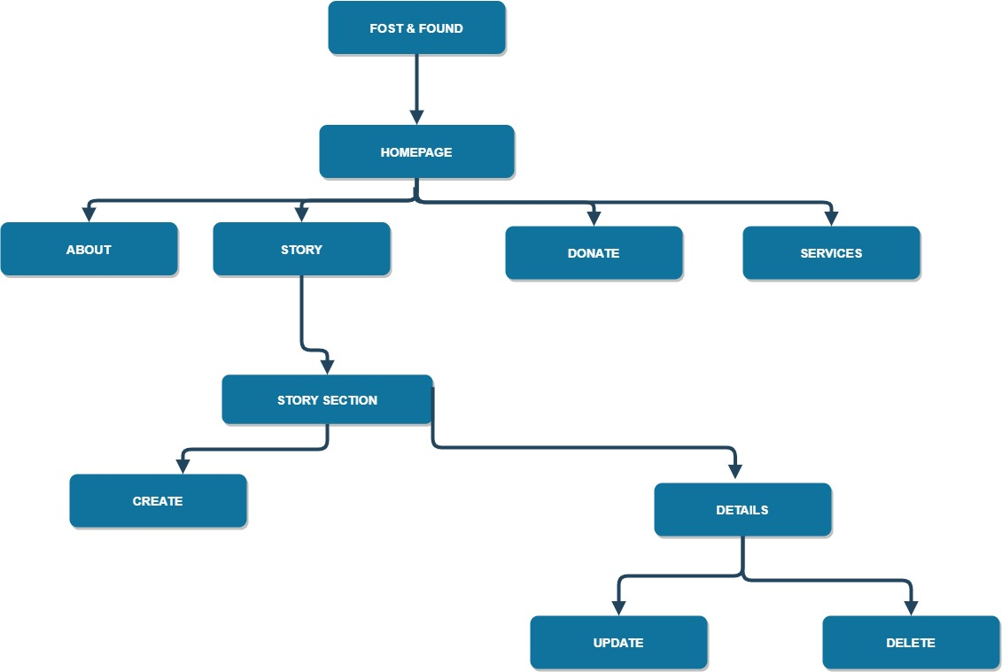

Slide 8
Technologies used
HTML
ANGULAR
NODE JS
JAVASCRIPT
BOOTSTRAP
CSS

Slide 9
DATABASE
STORIES
CREATE
UPDATE
DELETE
MONGODB

Slide 10
features
WEBSITE FEATURES
ACCESSIBILITY
VALIDATION
RESPONSIVE
USER FRIENDLY
EASY TO NAVIGATE
READ AND WRITE
KEYBOARD ACCESSIBILITY
ALT TEXT

Slide 11
WHAT TO EXPECT IN FUTURE?
Our group want to work on this project in future and make it better.
Now it’s just a start for us we want to spend some time and make this project live soon.
There are multiple features that we can add in this project.
At present , it is able to spread some knowledge about Foster lives to few people but there is unlimited scope for this project to be on bigger and better platform because it is for non-profitable organization.
We will add some more services to our website in future.

Slide 12

Thank you
gurjeet97chaudhary@gmail.com
shailja.thakur9@gmail.com
vohrarupali1@gmail.com

